Slide 1
Chapter 4
Physical Layer Design Issues

Slide 2
Unit 4:
Physical Layer Design Issues (4 Hours)
4.1 Transmission Medium, Network Topologies
4.2 Guided Transmission Media (Twisted Pair, Coaxial, Optical Fiber)
4.3 Unguided Transmission Media (Bluetooth, Wi-Fi, Cellular, Microwave, Satellite)
4.4 Twisted Pair Cabling, Labeling and Testing Standards

Slide 3
Network Topology
A network topology is the arrangement of devices (nodes) and connections (links) in a computer network.
It shows how computers, servers, and other devices are connected and how data flows between them.
There are two main types of topology:
Physical Topology: The actual physical layout of cables and devices.
Logical Topology: How data moves across the network, regardless of physical layout.

Slide 4
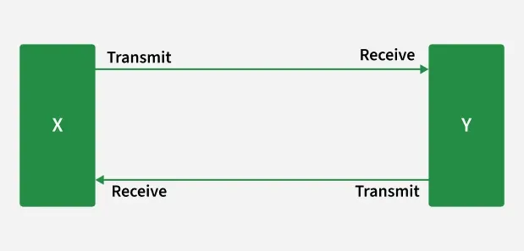
Point To Point Topology
Point-to-point topology is a type of topology that works on the functionality of the sender and receiver.
It is the simplest communication between two nodes, in which one is the sender and the other one is the receiver.
Point-to-Point provides high bandwidth.

Slide 5
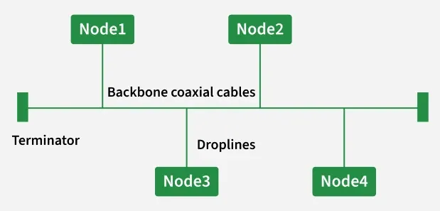
Bus Topology
Bus Topology is a network type in which every computer and network device is connected to a single cable.
It is bi-directional.
It is a multi-point connection and a non-robust topology because if the backbone fails the topology crashes.
Bus-topology Ethernet uses only the CSMA/CD MAC protocol.
TDMA, CDMA, Pure ALOHA, and Slotted ALOHA were never used in Ethernet.

Slide 6
Advantages of Bus Topology
If N devices are connected to each other in a bus topology, then the number of cables required to connect them is 1, known as backbone cable, and N drop lines are required.
Coaxial or twisted pair cables are mainly used in bus-based networks that support up to 10 Mbps.
The cost of the cable is less compared to other topologies, but it is used to build small networks.
Bus topology is familiar technology as installation and troubleshooting techniques are well known.
CSMA/CD was the only MAC method used in traditional bus Ethernet. Modern switched Ethernet does not use CSMA/CD because full-duplex operation eliminates collisions.
Disadvantages of Bus Topology
A bus topology is quite simpler, but still, it requires a lot of cabling.
If the common cable fails, then the whole system will crash down.
If the network traffic is heavy, it increases collisions in the network. To avoid this, various protocols are used in the MAC layer known as Pure Aloha, Slotted Aloha, CSMA/CD, etc.
Adding new devices to the network would slow down networks.
Security is very low.

Slide 7
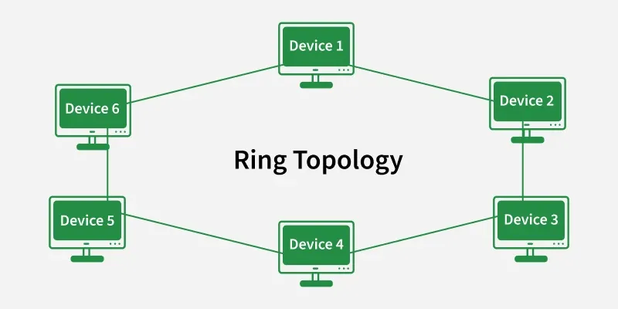
Ring Topology
In a Ring Topology, it forms a ring connecting devices with exactly two neighboring devices.
A number of repeaters are used for Ring topology with a large number of nodes, because if someone wants to send some data to the last node in the ring topology with 100 nodes, then the data will have to pass through 99 nodes to reach the 100th node.
Hence to prevent data loss repeaters are used in the network.
In-Ring Topology, the Token Ring Passing protocol is used by the workstations to transmit the data where, Token passing is a network access method in which a token is passed from one node to another node & Token is a frame that circulates around the network.

Slide 8
Advantages of Ring Topology
The data transmission is high-speed.
The possibility of collision is minimum in this type of topology.
Cheap to install and expand.
Disadvantages of Ring Topology
The failure of a single node in the network can cause the entire network to fail.
Troubleshooting is difficult in this topology.
Less secure.

Slide 9
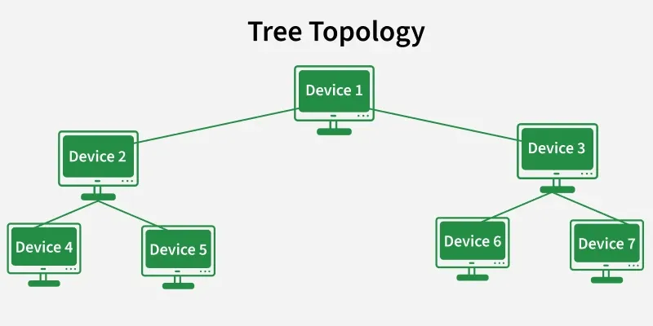
Tree Topology
Tree topology is the variation of the Star topology. This topology has a hierarchical flow of data. In Tree Topology, protocols like DHCP and SAC (Standard Automatic Configuration) are used.
Here, various secondary hubs are connected to the central hub which contains the repeater.
This data flow from top to bottom i.e. from the central hub to the secondary and then to the devices or from bottom to top i.e. devices to the secondary hub and then to the central hub.
It is a multi-point connection and a non-robust topology because if the backbone fails the topology crashes.

Slide 10
Advantages of Tree Topology
It allows more devices to be attached to a single central hub thus it decreases the distance that is traveled by the signal to come to the devices.
It allows the network to get isolated and also prioritize from different computers.
We can add new devices to the existing network.
Disadvantages of Tree Topology
If the central hub gets fails the entire system fails.
The cost is high because of the cabling.
If new devices are added, it becomes difficult to reconfigure.

Slide 11
Mesh Topology
In a mesh topology, every device is connected to another device via a particular channel.
Every device is connected to another via dedicated channels. These channels are known as links. In Mesh Topology, the protocols used are AHCP (Ad Hoc Configuration Protocols), DHCP (Dynamic Host Configuration Protocol), etc.
Suppose, the N number of devices are connected with each other in a mesh topology, the total number of ports that are required by each device is N−1
In Figure , there are 6 devices connected to each other, hence the total number of ports required by each device is 5. The total number of ports required = N * (N-1)
Suppose, N number of devices are connected with each other in a mesh topology, then the total number of dedicated links required to connect them is i.e. N * (N-1)/2 .
In Figure, there are 6 devices connected to each other, hence the total number of links required is 6 * 5/2 = 15

Slide 12
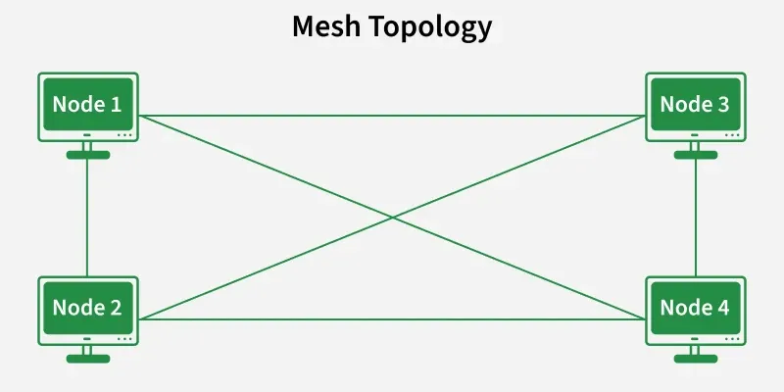

Slide 13
Advantages of Mesh Topology
Communication is very fast between the nodes.
Mesh Topology is robust.
The fault is diagnosed easily. Data is reliable because data is transferred among the devices through dedicated channels or links.
Provides security and privacy.
Disadvantages of Mesh Topology
Installation and configuration are difficult.
The cost of cables is high as bulk wiring is required, hence suitable for less number of devices.
The cost of maintenance is high.

Slide 14
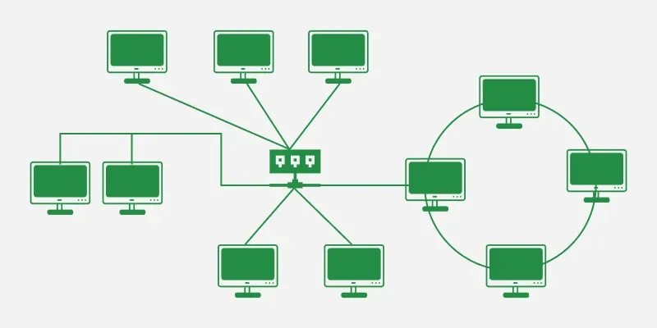
Hybrid Topology
Hybrid Topology is the combination of all the various types of topologies we have studied above.
Hybrid Topology is used when the nodes are free to take any form.
It means these can be individuals such as Ring or Star topology or can be a combination of various types of topologies seen above.
Each individual topology uses the protocol that has been discussed earlier.

Slide 15
Advantages of Hybrid Topology
This topology is very flexible.
The size of the network can be easily expanded by adding new devices.
Disadvantages of Hybrid Topology
It is challenging to design the architecture of the Hybrid Network.
Hubs used in this topology are very expensive.
The infrastructure cost is very high as a hybrid network requires a lot of cabling and network devices .

Slide 16
Bounded transmission media, also known as guided media or wired media, refers to the physical media through which signals are transmitted in a computer network.
Unlike wireless transmission, bounded transmission media rely on physical cables or wires to carry data signals between network devices.
Here are some common types of bounded transmission media:
Twisted Pair Cable: Twisted pair cable consists of pairs of insulated copper wires twisted together to reduce electromagnetic interference.
It is widely used for Ethernet networks and telephone systems.
There are two main types of twisted pair cables:
Unshielded Twisted Pair (UTP): UTP cables are commonly used in Ethernet networks. They have no additional shielding and rely on the twisting of wire pairs to reduce interference.
UTP cables are classified into different categories (e.g., Cat5e, Cat6) based on their performance and data transmission capabilities.
2. Shielded Twisted Pair (STP): STP cables have additional shielding to provide better protection against electromagnetic interference.
They are used in environments with high levels of interference, such as industrial settings.

Slide 17
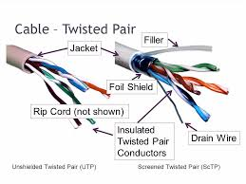

Slide 18
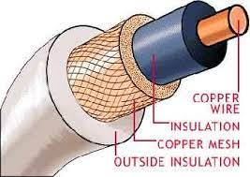
2.Coaxial Cable: Coaxial cable consists of a central conductor, an insulating layer, a metallic shielding, and an outer insulating layer.
It is widely used in cable television (CATV) networks and broadband internet connections.
Coaxial cable provides better resistance to interference compared to twisted pair cable.

Slide 19
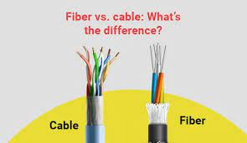
3.Fiber Optic Cable: Fiber optic cable uses thin strands of glass or plastic fibers to transmit data signals using light.
It offers high bandwidth, low signal loss, and immunity to electromagnetic interference.
Fiber optic cables are commonly used in long-distance telecommunications, high-speed internet connections, and data center networks.

Slide 20
Unbounded transmission media (micro wave, satellite)
Unbounded transmission media, also known as unguided or wireless media, refers to the means of transmitting signals without the use of physical cables or wires.
Two common examples of unbounded transmission media are microwave and satellite communications:

Slide 21
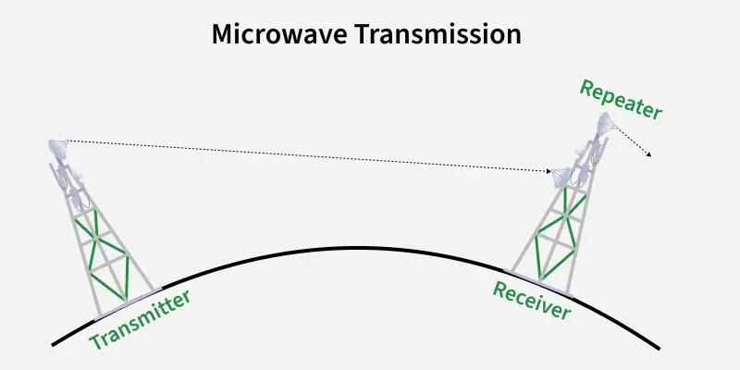
Microwave Communication:
Microwave communication involves the use of high-frequency radio waves to transmit signals over the air.
It requires line-of-sight propagation, where microwave antennas are placed at fixed locations to establish a communication link.
Microwave communication is often used for point-to-point communication between two fixed locations, such as in long-distance telephone networks and wireless backhaul for cellular networks.
Microwave communication offers high bandwidth and low latency, making it suitable for transmitting large amounts of data over long distances.
However, it is harmed to interference from physical obstacles like buildings and natural obstructions, which can degrade the signal quality.

Slide 22
Advantages:
Cheaper than using cables
Freedom from land acquisition
Ease of communication in difficult terrains
Communication over oceans
Disadvantages:
Insecure communication.
Out of phase signal.
Susceptible to weather conditions.
Bandwidth is limited.
High cost of design, implementation, and maintenance.

Slide 23
Satellite Communication: Satellite communication involves the use of communication satellites that orbit the Earth to transmit and receive signals over a wide coverage area.
It relies on microwave signals for uplink (transmitting data from the ground to the satellite) and downlink (transmitting data from the satellite to the ground).
In satellite communication, the ground-based transmitter and receiver communicate with a satellite, which acts as a relay station to transmit signals to other locations on Earth.
Satellite communication enables long-distance communication across vast areas, making it valuable for global telecommunications, television broadcasting, and internet connectivity in remote regions.
Satellite communication offers wide coverage, allowing communication in areas where terrestrial infrastructure is limited or nonexistent.
However, it introduces higher latency due to the longer distance the signals have to travel to reach the satellite and back to Earth.

Slide 24
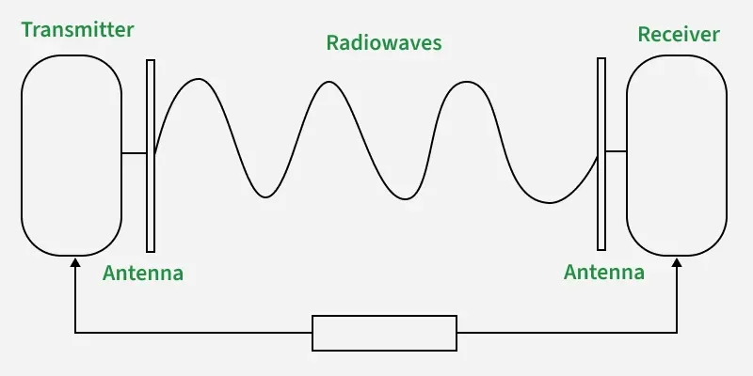
Radio Waves
Radio waves are easy to generate and can penetrate through buildings. The sending and receiving antennas need not be aligned.
Frequency Range: 3KHz - 1GHz3KHz - 1GHz. AM and FM radios and cordless phones use Radio waves for transmission.
Types of Radio Waves:
Short Wave: AM Radio
VHF (Very High Frequency): FM Radio/TV
UHF (Ultra High Frequency): TV
Radio Wave Components:
Transmitter: Responsible for encoding the signal.
Receiver: Responsible for decoding the signal.

Slide 25
Wi-Fi
Wi-Fi is a wireless technology using radio waves .
Based on IEEE 802.11 standards) to connect devices (phones, laptops, etc.)
To the internet and each other without cables, through a wireless router that broadcasts the signal, enabling high-speed data exchange for browsing, streaming, and communication in homes, businesses, and public spaces.
It's a method of local area networking (LAN) that's distinct from the internet itself but provides access to it

Slide 26
How it Works
Internet Source: An internet connection comes to your location via a modem, usually through a cable or fiber line.
Wireless Router: The modem connects to a wireless router, which acts as the central hub.
Radio Waves: The router converts the internet data into radio signals and broadcasts them.
Device Connection: Your Wi-Fi-enabled device (phone, laptop) picks up these radio waves using its internal antenna, translating them back into usable data.
Two-Way Communication: Your device sends data back to the router using the same radio waves, allowing you to browse, stream, and communicate.

Slide 27
Key Aspects
Standards: Governed by IEEE 802.11 standards (like Wi-Fi 6, Wi-Fi 7), which define speed, range, and efficiency.
Frequencies: Operates on specific radio frequencies, typically 2.4 GHz and 5 GHz (and 6 GHz for Wi-Fi 6E).
Accessibility: Allows devices to connect from anywhere within the router's range, offering freedom from physical wires.
Wi-Fi vs. Internet: Wi-Fi is the access method (wireless connection), while the Internet is the global network of information; you need both for online access.

Slide 28
Bluetooth
Bluetooth is a wireless technology standard used for short-range data exchange between devices like phones, headphones, and computers without cables.
It works by using low-power radio waves to create a personal area network, allowing compatible devices to pair and communicate.
This is useful for connecting devices such as headsets, speakers, and game controllers.

Slide 29
How it works
Discovery: One device, a "discoverable device," makes itself available to connect to.
Pairing: For two devices to communicate, they must first be paired, which involves a one-time setup process.
Bonding: The other device finds the discoverable device and initiates a pairing request. Once accepted, they exchange security keys and create a bond for future connections.
Connection: After pairing and bonding, the devices can exchange data as long as they are within range (typically up to 10 meters or about 30 feet).
Automatic Reconnection: Once bonded, the devices can reconnect automatically in the future without repeating the pairing process, as long as they are in range and have not been unpaired

Slide 30
Common uses
Wireless headsets and speakers
Connecting keyboards, mice, and controllers to computers and gaming consoles
Pairing smartwatches and fitness trackers with smartphones
Transferring files like photos between devices
Connecting a phone to a car's audio system for calls and music

Slide 31
Advantages and disadvantages
Advantages:
Convenient and wire-free connections
Low power consumption, suitable for battery-powered devices
Widely supported across many devices
Secure and encrypted data transmission
Disadvantages:
Limited range compared to Wi-Fi
Slower data transfer rates than some other wireless technologies
Can be vulnerable to hacking

Slide 32
Cabling Standards (TIA/EIA-568 and ISO/IEC 11801)
The primary standard for commercial building telecommunications cabling is the ANSI/TIA-568 series in North America, and the equivalent ISO/IEC 11801 series internationally.
These standards define performance requirements, cable categories, and installation practices.
Cable Categories/Classes: These standards define categories (Cat) in TIA and classes in ISO for balanced twisted-pair cables, specifying minimum performance requirements, bandwidth, and supported applications.
Common examples include Cat5e, Cat6, Cat6a, and Cat7, with higher numbers indicating better performance.
Maximum Lengths: A universal standard for horizontal cabling (permanent links) is a maximum length of 90 meters of installed cable, with a total channel length (including patch cords) not exceeding 100 meters.
Wiring Sequence (Pinouts): The TIA-568 standard defines two specific wiring sequences for terminating an eight-position RJ45 connector:
T568A: Follows a sequence of green-white/green, orange-white/blue, blue-white/orange, brown-white/brown.
T568B: Follows a sequence of orange-white/orange, green-white/blue, blue-white/green, brown-white/brown.
Both are technically equivalent; the only difference is the swapping of the orange and green pairs. The critical rule is to use the same standard (either A or B) on both ends for a straight-through cable, while a crossover cable uses one standard on each end.

Slide 33
Labeling Standards (TIA-606-B/C/D)
The ANSI/TIA-606 standard provides voluntary guidelines for administration, including labeling and record-keeping for cabling infrastructure.
Durability and Legibility: Labels must be permanent, durable, and machine-printed for clarity (handwriting is a poor practice).
Placement: All cables, patch panels, and termination points must be labeled at both ends to ensure efficient management and troubleshooting.
Content: Labels should clearly identify the unique Cable ID, as well as the source and destination points. Including cable type (e.g., Cat6a) and length is considered a best practice.
Color-coding: Color-coding schemes can be used on labels or cable jackets to quickly identify the type of cable or application (e.g., standard Ethernet, PoE)

Slide 34
Testing Standards (TIA-1152 and IEC 61935-1)
Cabling installations must be verified through field certification testing to ensure they meet performance requirements and can support intended applications. The main standards for field testing are ANSI/TIA-1152 (North America) and IEC 61935-1 (International).
Key test parameters verified by certification testers include:
Length: Ensures the cable link is within the 100m maximum channel length.
Attenuation: Measures signal loss along the cable length.
Near-End Crosstalk (NEXT) & Power Sum ACR (PS-ACR): Measures signal coupling/interference between wire pairs within the cable.
Return Loss: Measures reflections caused by impedance mismatches.
DC Resistance: Measures the electrical resistance of the wire pairs, important for Power over Ethernet (PoE) applications.

